Slide 1

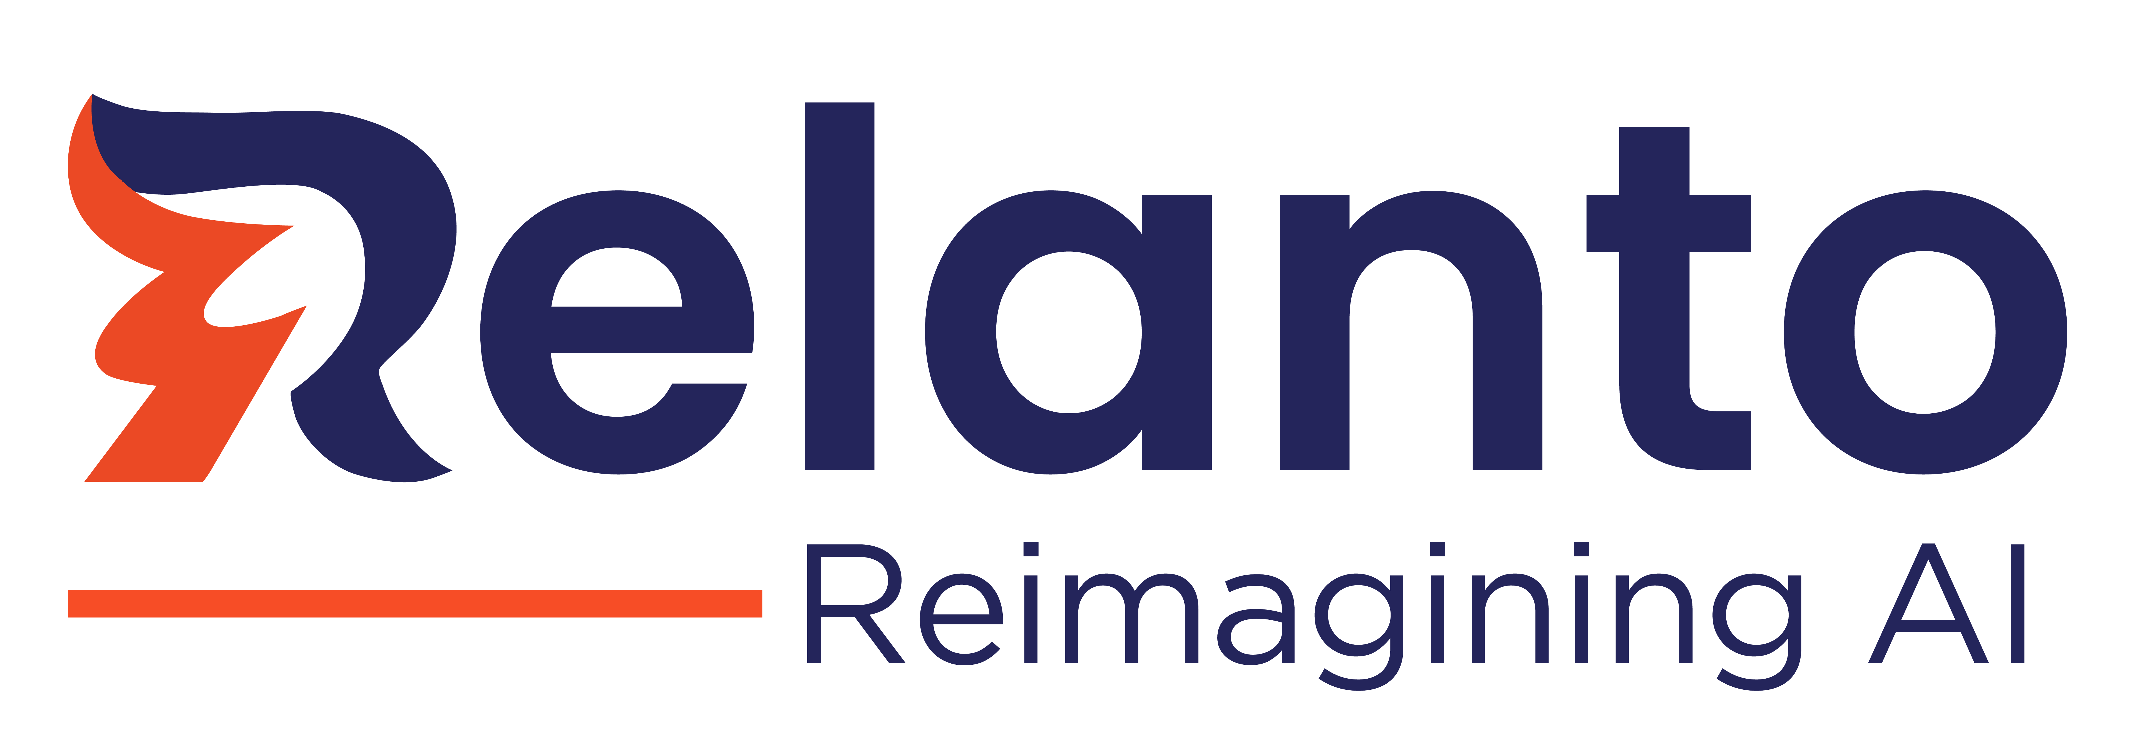

Case Studies - AI
Copyright © 2024 Relanto Inc. All rights reserved.

Slide 2
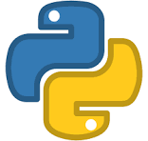

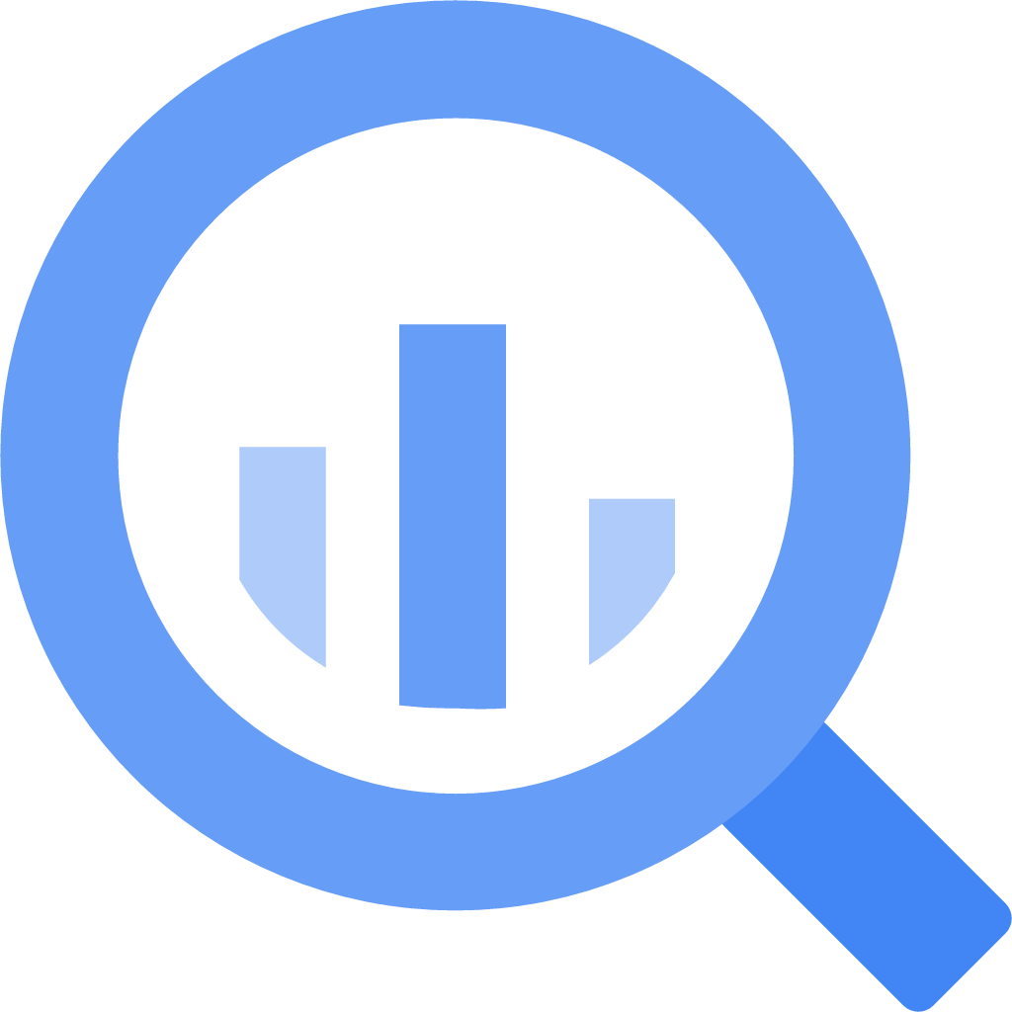



AI-Powered Insights Generation
Business Context: A leading global financial enterprise sought an innovative solution to address inefficiencies in their operational workflows. The objective was to develop an AI-powered platform designed to provide real-time insights into budgets and ROI, eliminating delays caused by traditional methods. By leveraging conversational AI, the system aimed to streamline access to critical financial data, reduce manual effort, and empower professionals to focus on high-value strategic tasks.
Value Delivered
Real-time insights allowed finance teams to act swiftly and optimize strategies.
Streamlined data access reduced dependency on teams and saved significant time.
Insights into trends and ROI helped refine financial strategies for maximum impact.
An intuitive chatbot reduced barriers to data access, improving user satisfaction.
Challenges
Solutions
Users faced difficulties navigating multiple dashboards and systems to gather budget insights. The solution required a unified conversational interface to simplify this process.
Aggregating data from systems like Salesforce, BigQuery, and finance tools required developing robust connectors and seamless APIs.
Providing instant responses to natural language queries necessitated scalable AI models for on-the-fly data processing and trend analysis.
The lack of an intuitive, user-friendly interface needed to be addressed with a conversational design that could understand and respond effectively to queries from finance professionals.
Leveraged ML models and NLP to provide actionable insights on budget and ROI in real-time, such as cost per deal or campaign performance metrics.
Enabled users to input queries in natural language, simplifying the process of retrieving investment and financial insights. This user-friendly interface reduced the complexity of data navigation, improving accessibility and overall user experience.
Incorporated trend and pattern analysis to empower users with foresight into ROI and spending efficiency. By forecasting future outcomes, finance teams could proactively adjust their strategies to maximize ROI.
Integration with disparate datasets allowed for real-time access to comprehensive datasets, eliminating the need for manual aggregation.
Technology Stack

Slide 3
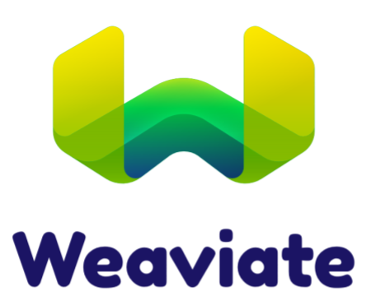
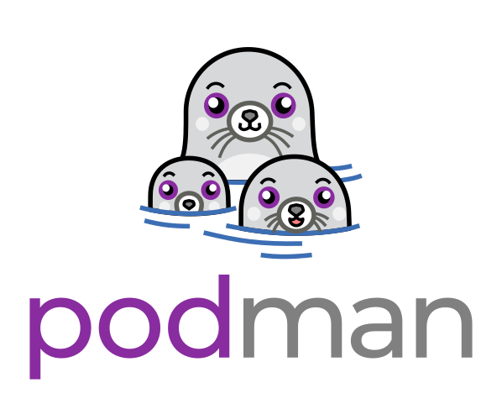
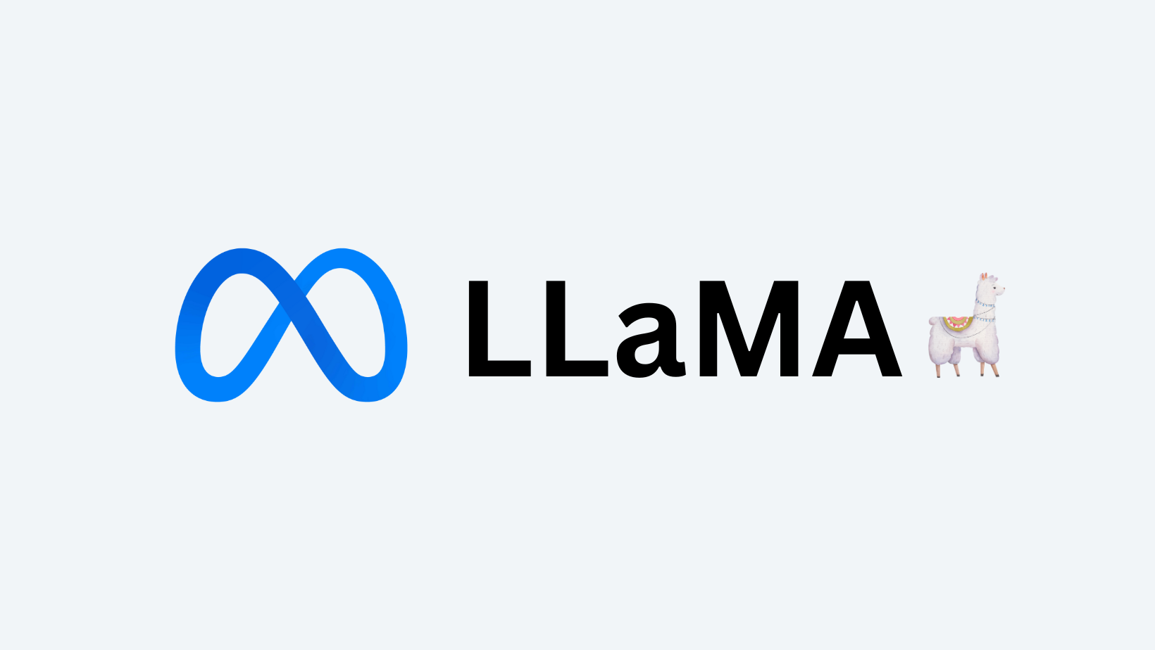
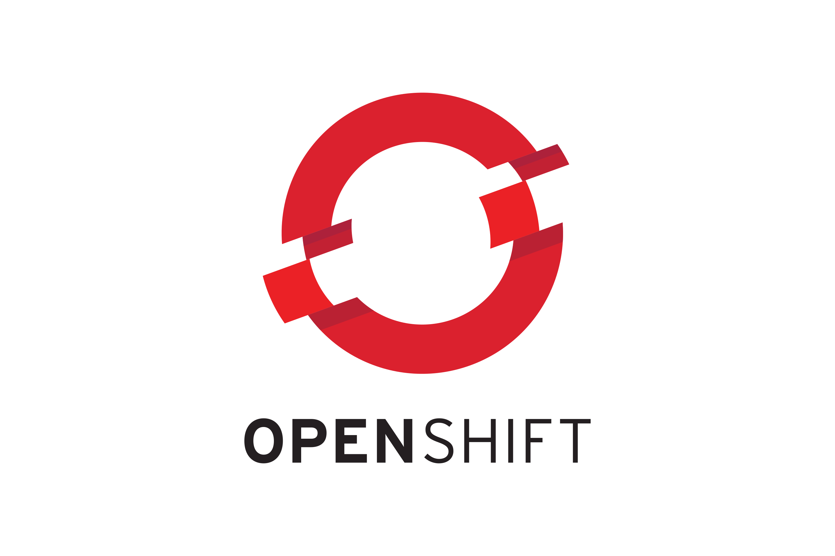
AI-Powered Incident Resolution System
Business Context: A global enterprise Hi-Tech leader, sought an advanced solution to improve their incident management system. The objective was to develop a Gen AI-powered chatbot capable of diagnosing and resolving incidents in real-time, providing accurate solutions, and reducing response times. This system aimed to automate routine incident resolution, enhance operational efficiency, and reduce the burden on IT support teams, ensuring faster and more accurate issue resolution for both internal teams and users.
Value Delivered
Optimized user experience through a smart, AI-driven chatbot that offers real-time, tailored incident resolutions.
Automated issue diagnosis and resolution, freeing up IT support teams to focus on more complex tasks.
Seamless and secure integration with Client's infrastructure, meeting all technical requirements.
Challenges
Solutions
One of the major challenges was gaining a deep understanding of Client's business needs, identifying the various types of incidents, and mapping them to suitable AI-driven solutions to ensure accurate and effective incident resolution.
Another challenge involved designing a system capable of intelligently routing user inputs through the chatbot to the appropriate solution type, such as unstructured responses, text-to-SQL queries, or other specialized solutions based on the incident type.
Understanding Client’s complex infrastructure and ensuring the AI solution met stringent security standards posed a significant challenge, requiring seamless integration and compliance with their environment.
Successfully deploying the AI-driven chatbot on client’s environment while ensuring scalability, performance, and minimal downtime was another key challenge that required meticulous planning and execution.
Client's knowledge documents and incident data were analyzed, with incident descriptions and summaries being matched to relevant knowledge using cosine similarity and vector embeddings, ensuring accurate incident resolution suggestions.
A routing mechanism using a Large Language Model (LLM) was developed to classify user queries and direct them to the appropriate solution type, such as unstructured responses or text-to-SQL queries, ensuring precise resolutions.
The solution was successfully deployed following Client’s deployment criteria and compliance with technical specifications.
Training on Client's infrastructure and security protocols was undertaken to ensure a proper understanding of their environment. This knowledge enabled the integration of the AI-driven chatbot with Client’s systems while meeting all necessary security and compliance requirements.
Technology Stack

Slide 4
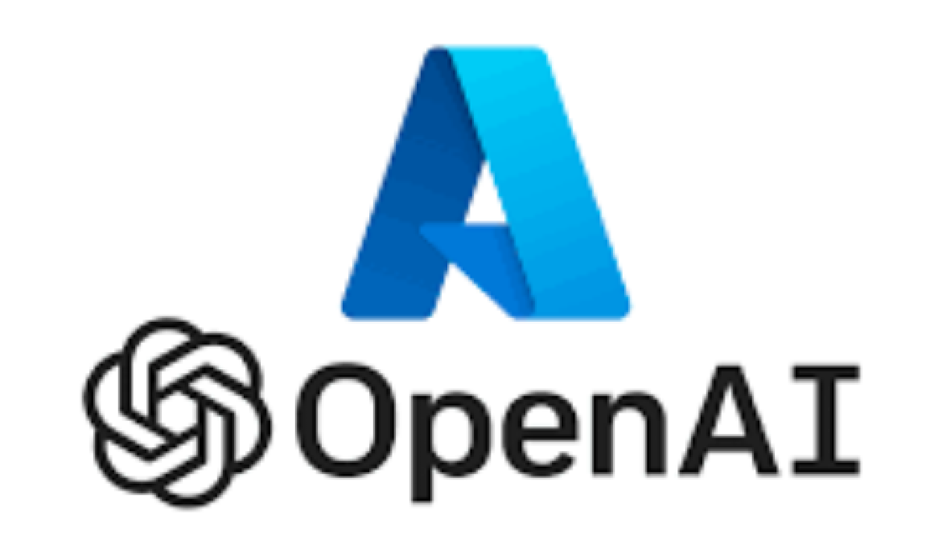

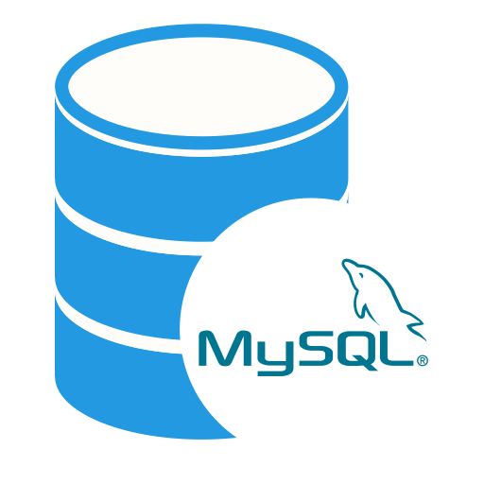


Gen AI-Based Sales Co-Pilot Chatbot
Business Context: A leading technology company required a dynamic solution to provide instant access to crucial sales information for their professionals. The objective was to develop a chatbot tailored specifically for sales personnel, enabling them to query key metrics such as renewals, target compensation, comparisons, and sales forecasting. Leveraging both structured and unstructured data, the bot aimed to provide seamless access to information, enhancing sales efficiency.
Value Delivered
Self-service access to sales data right at their fingertips
Improved sales performance and customer relationships
Real-time sales data and forecasts bettered Decision-Making
Data-driven insights and Faster Response
Solution Implemented
Advanced AI Integration
Data Integration and Processing
Developed AI-driven chatbot designed to process/handle queries sales-related questions, covering inquiries regarding renewals, target adjustments, compensation details, sales metric comparisons, and sales forecasting
Integrated Azure OpenAI's Large Language Model for advanced natural language processing and generating responses, ensuring seamless interaction during conversations with users.
Implemented RAG (Retrieval Augmented Generation) to enhance chatbot responses with relevant information retrieved from structured and unstructured data sources to provide thorough and contextually relevant answers to user queries.
Integrated Langchain and Llama Index for efficient retrieval of information, ensuring rapid response times.
Integrated structured databases (e.g., MySQL) to store various sales-related datasets, including historical sales records, customer profiles, target metrics, compensation structures, and buying patterns..
Utilized Chroma Vector Database to effectively manage unstructured data from diverse sources, such as PDF documents containing sales forecasts, market analyses, competitor reports, and customer feedback.
Established robust connections to structured databases for real-time data synchronization and implemented automated document parsing for efficient indexing and retrieval of relevant content from PDFs..
Developed intelligent query routing algorithms within the chatbot to identify the appropriate data source (structured or unstructured) based on the nature of the inquiry.
Technology Stack
Vector DB

Slide 5
AI-Powered Automated Data Capture & Entry
Business Context: A leading global enterprise sought an innovative solution to address inefficiencies in their operational workflows. The objective was to develop an AI-powered platform designed to automate form-filling and data entry, reducing the burden of manual tasks. This system aimed to empower marketers by freeing up their time for strategic initiatives, minimizing errors, and streamlining data management processes to drive productivity and business growth.
Value Delivered
Marketers reclaimed over 30% of their time previously spent on manual tasks.
Reduced errors and maintained data consistency across systems.
Streamlined workflows, enabling faster campaign execution and reporting.
Empowered marketers to focus on high-impact activities, contributing directly to revenue generation.
Challenges
Solutions
Lack of an interactive and user-friendly form-filling experience made the process tedious and less engaging for marketers. To address this, the solution needed to integrate an intuitive conversational form-filling mechanism that could guide users dynamically while capturing the necessary data accurately.
Mapping diverse data sources, including emails, Google Drives, webpages, and social media platforms, to ensure seamless integration into the platform. This required creating connectors and APIs that could handle data ingestion at scale while preserving the integrity and structure of the collected information.
Developing mechanisms for validation and error correction to maintain high standards of data quality. Advanced ML algorithms and rule-based systems were deployed to cross-verify data consistency across multiple sources.
Designing a system compatible with existing marketing tools and capable of handling the scale and complexity of global marketing operations. This involved developing scalable backend infrastructure and implementing robust data pipelines to manage peak workloads efficiently.
Leveraging advanced OCR and ML technologies, FormEase AI extracts and organizes unstructured data from multiple sources, including documents, emails, and online platforms. The system intelligently processes this information, ensuring it is categorized and stored effectively.
Implemented an interactive, AI-driven conversational form-filling feature to enhance user experience and engagement. This functionality used natural language processing (NLP) to guide users step-by-step through data entry processes, making it easier and more intuitive for marketers.
Automatically populates forms with relevant data, reducing manual intervention and the likelihood of errors. The solution employed a routing mechanism powered by a Large Language Model (LLM) to classify user inputs and dynamically adapt to specific data req
Processes captured data through validation checks to ensure consistency and quality before seamless ingestion into marketing systems like BigQuery for analytics. Multi-layered validation mechanisms, including AI-driven anomaly detection, were implemented to identify and rectify potential errors in real time.
Technology Stack

Slide 6
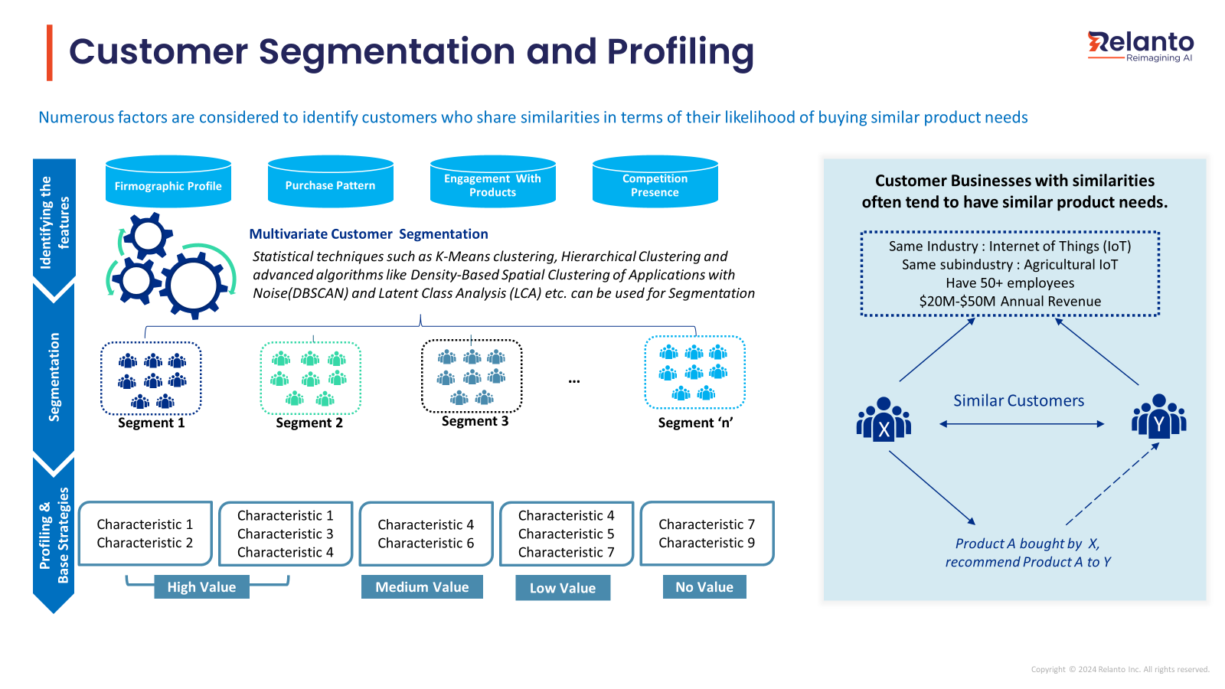
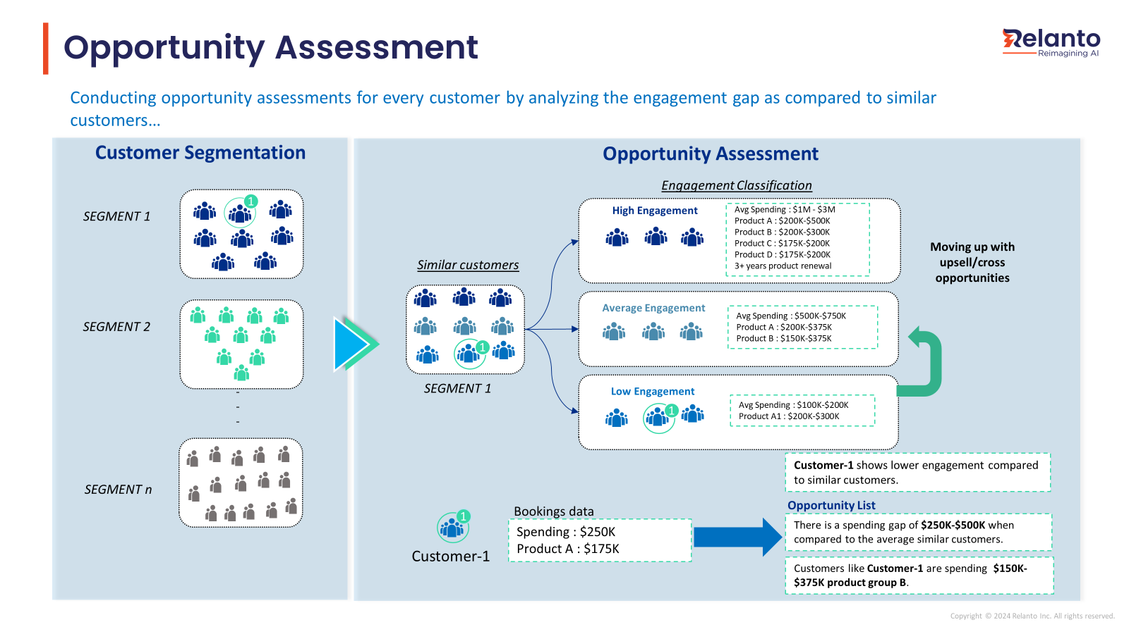
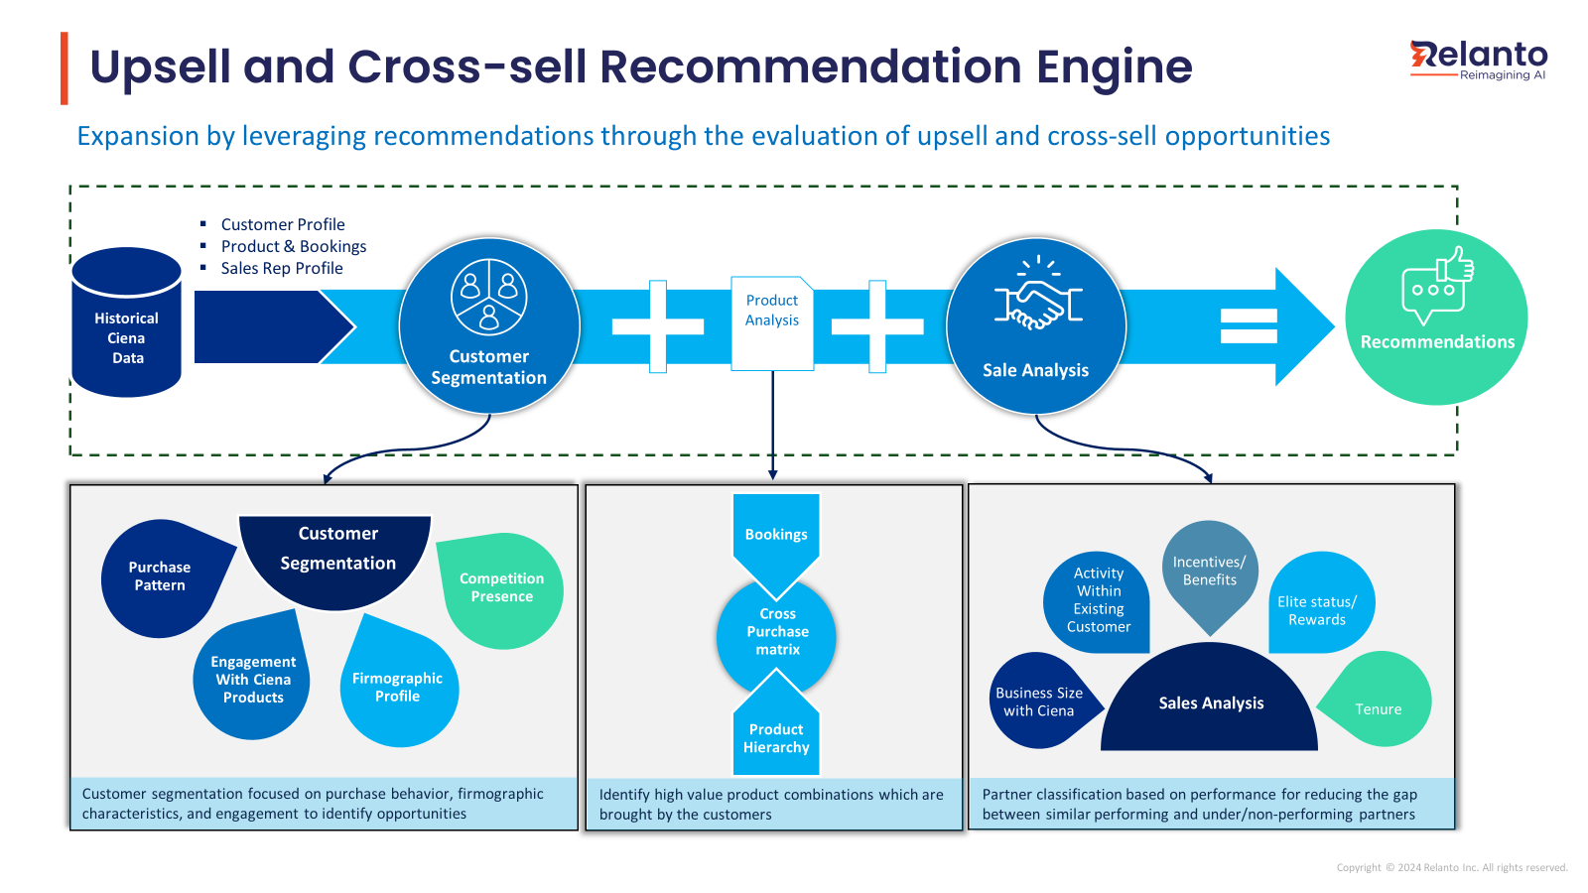
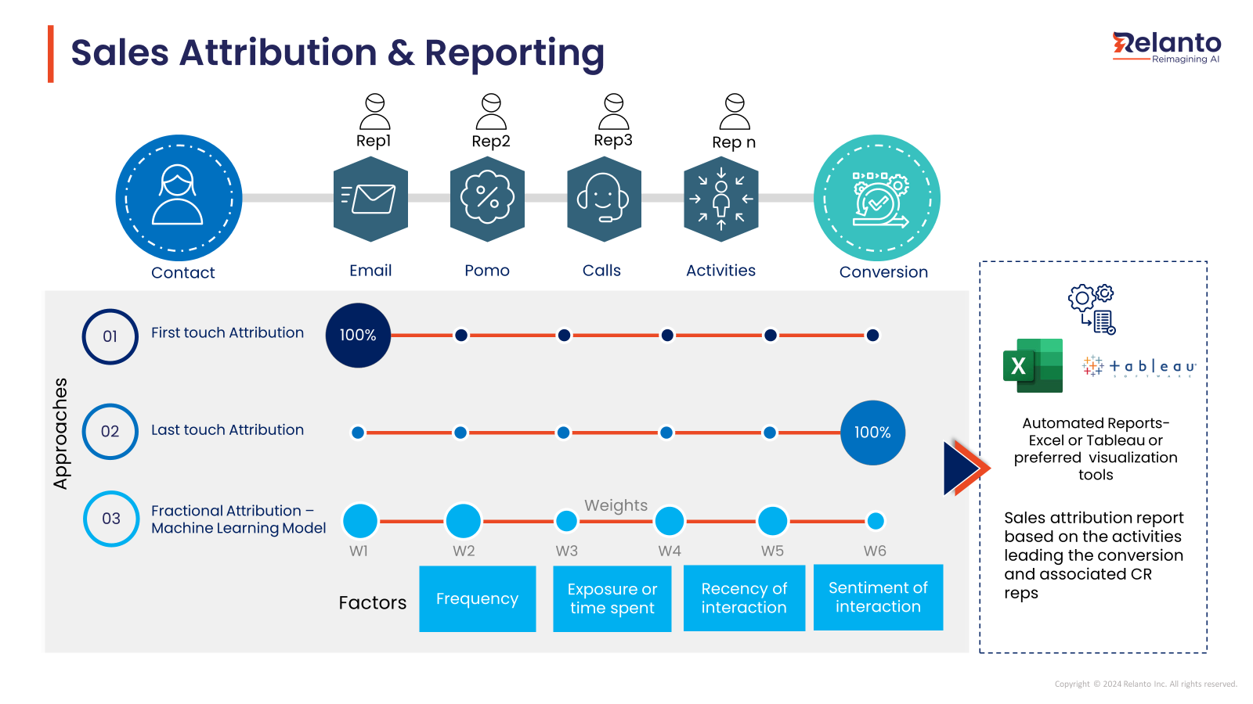
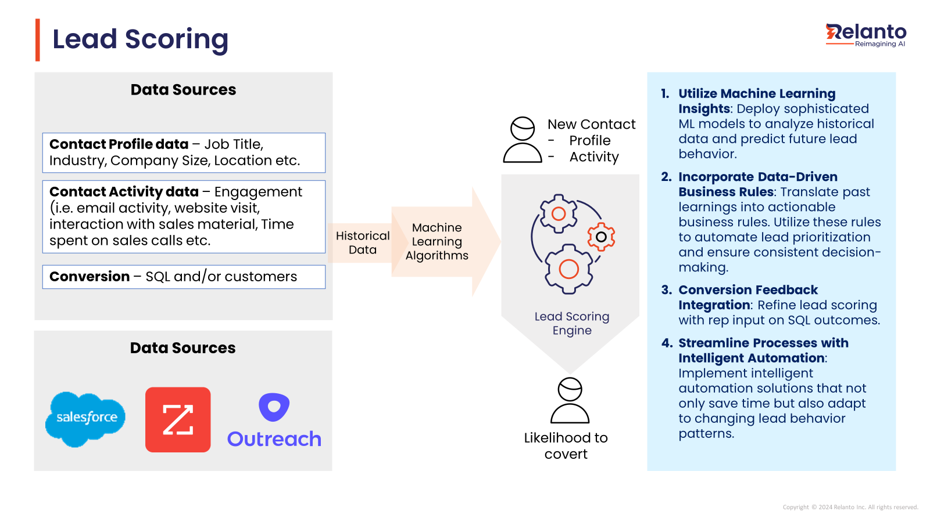
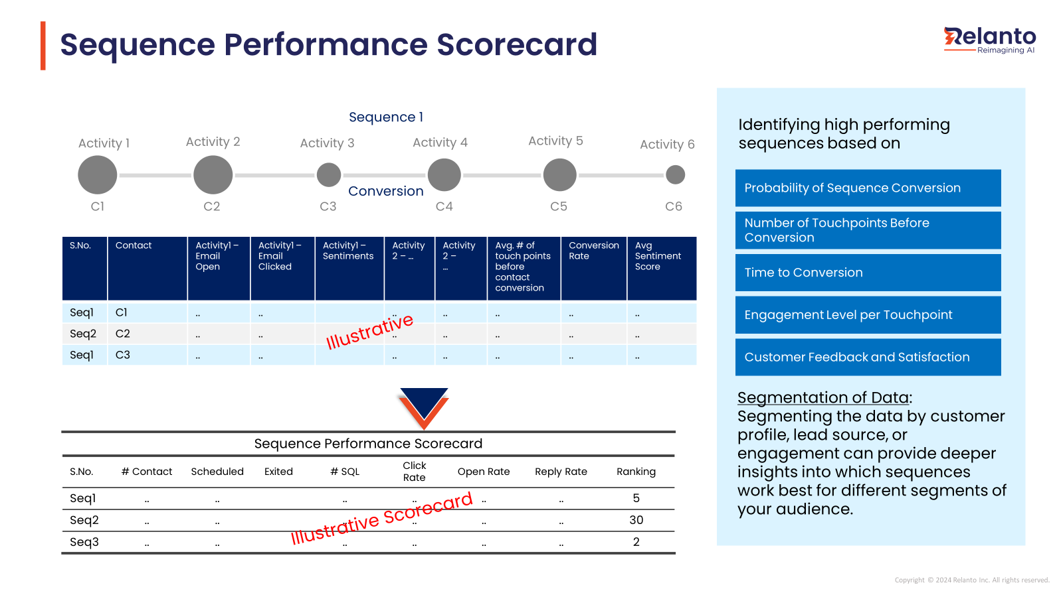
Mini Case Studies: Enterprise AI Capabilities Delivered
Customer Segmentation & Profiling
Opportunity Assessment
Sales Recommendation Engine
Sales Rep Attribution
Lead Scoring
Sequence Performance Dashboard

Slide 7
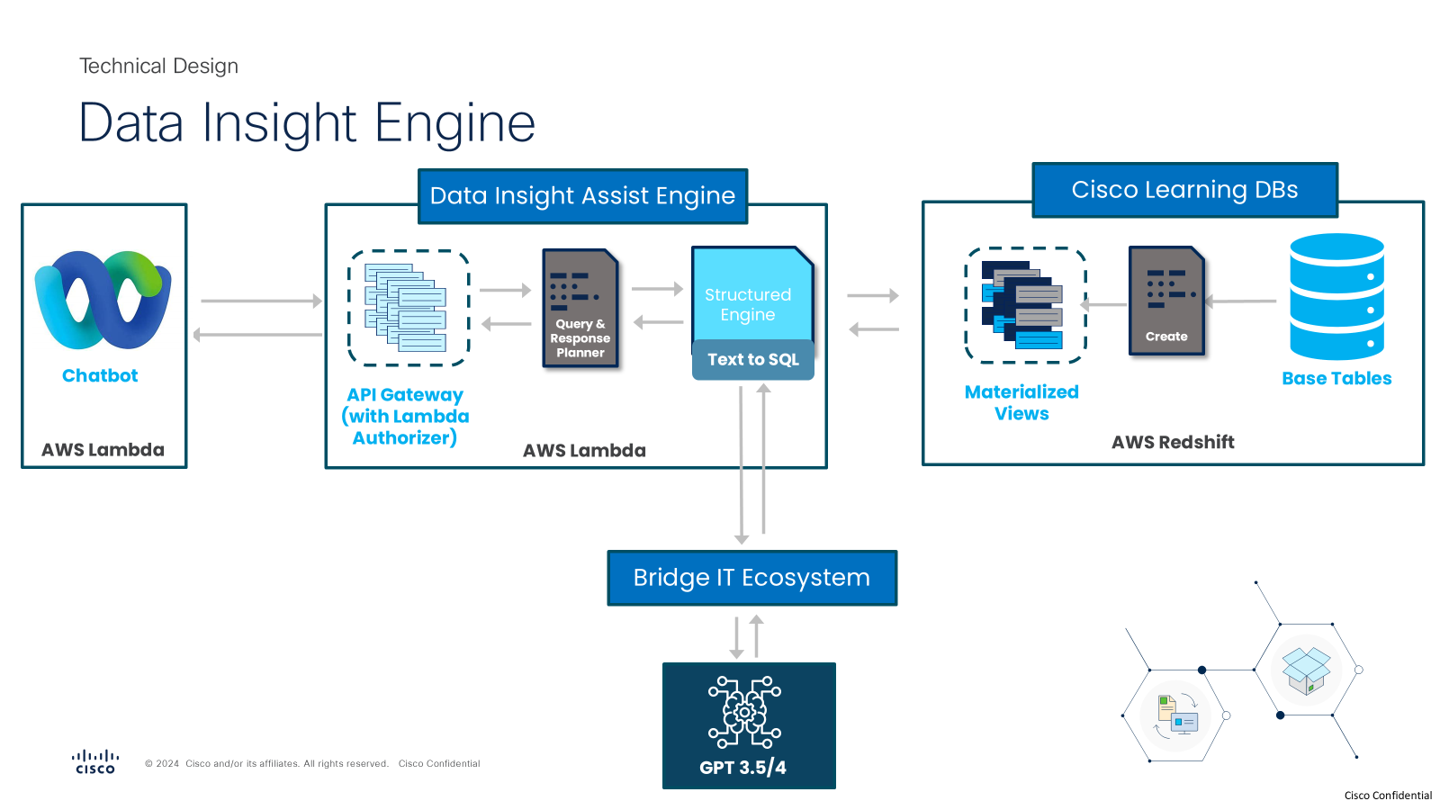
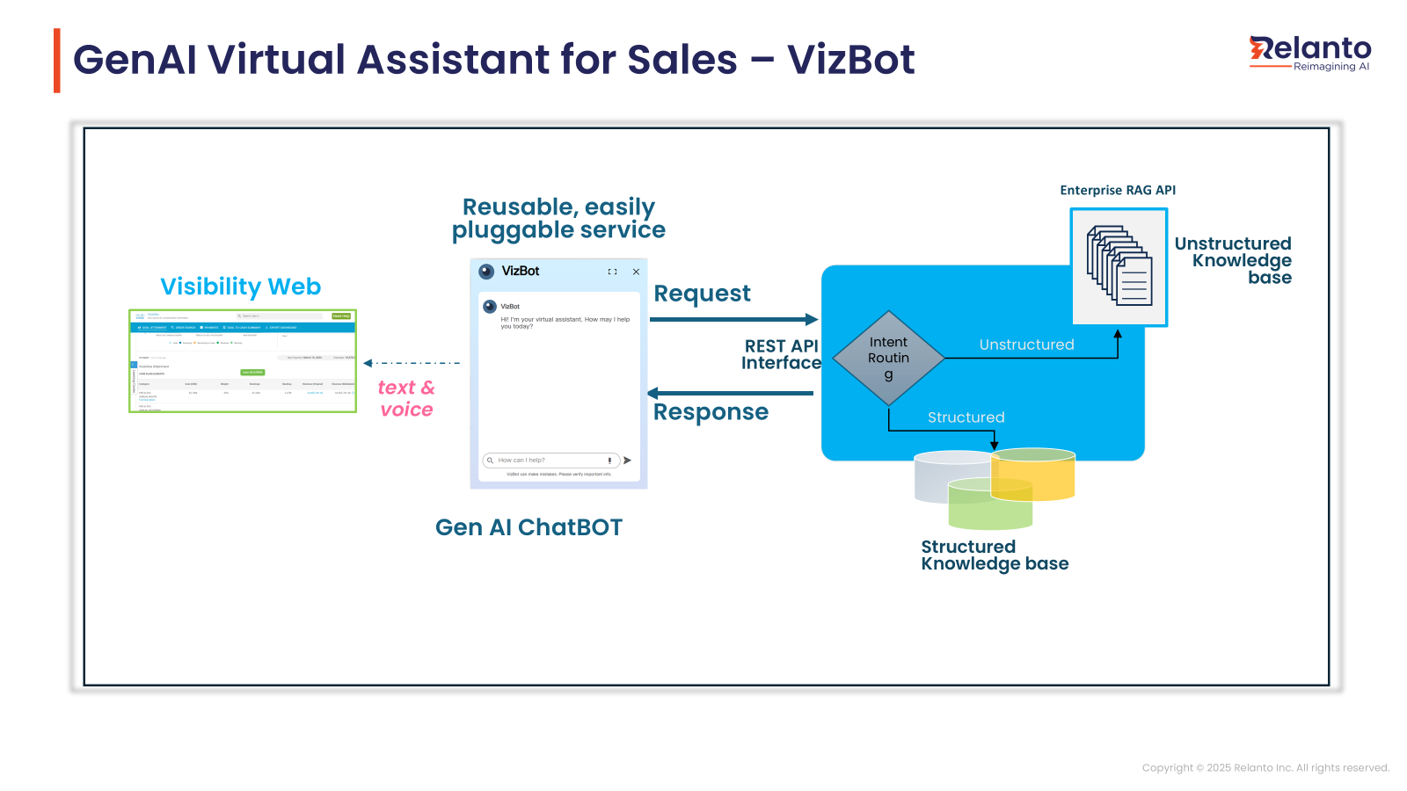
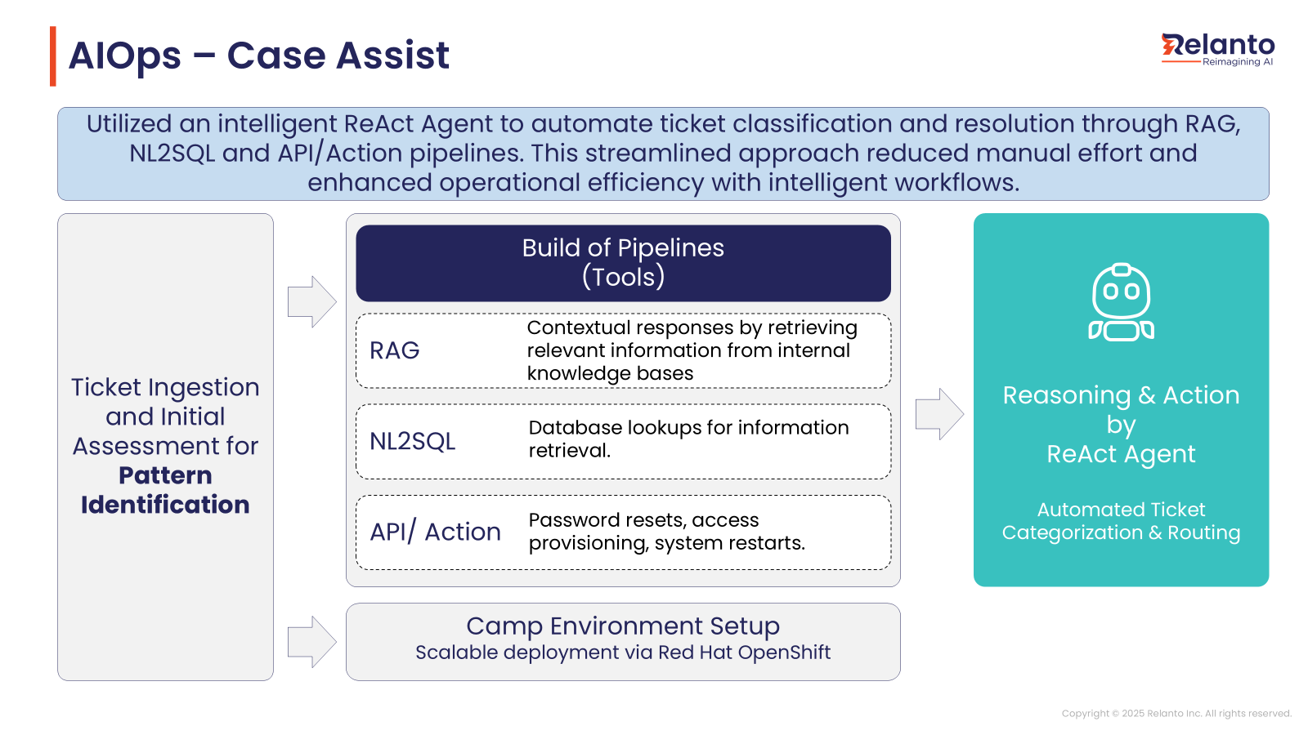
AI Use Cases Implemented at Cisco
Data Insight – Learning & Development | Leveraging Bridge IT
VizBot – Seller Comp | Leveraging Bridge IT
PRM - AI Ops/Case Assist | Leveraging CAMP
Challenge How can non-technical users easily explore and analyze data using everyday language?
Solution
Simplify data access with natural language queries
Enable direct, informed decision-making
Benefits
Faster, streamlined decisions
Reduce reliance on technical teams for routine data retrieval
User-centric, dynamic insights
Greater query flexibility
Challenge How can partners easily explore and analyze their sales compensation data using everyday language?
Solution
Simplify data access with natural language queries
Instantaneous FAQ resolution
Benefits
Faster, streamlined decisions
Reduce reliance on technical teams for routine data retrieval
User-centric, dynamic insights
Greater query flexibility
Challenge Rapidly evolving PXP drives higher case counts, causing delays, inefficiencies, and rising support costs due to manual, layered processes.
Solution
Co-Pilot: NLP conversational bot for real-time answers and guided troubleshooting.
Automated Ticketing: Real-time tracking, classification, and routing via ServiceNow.
Benefits
Improved efficiency and reduced manual work
Lower operational costs
Faster, more accurate support leading to higher customer satisfaction

Slide 8
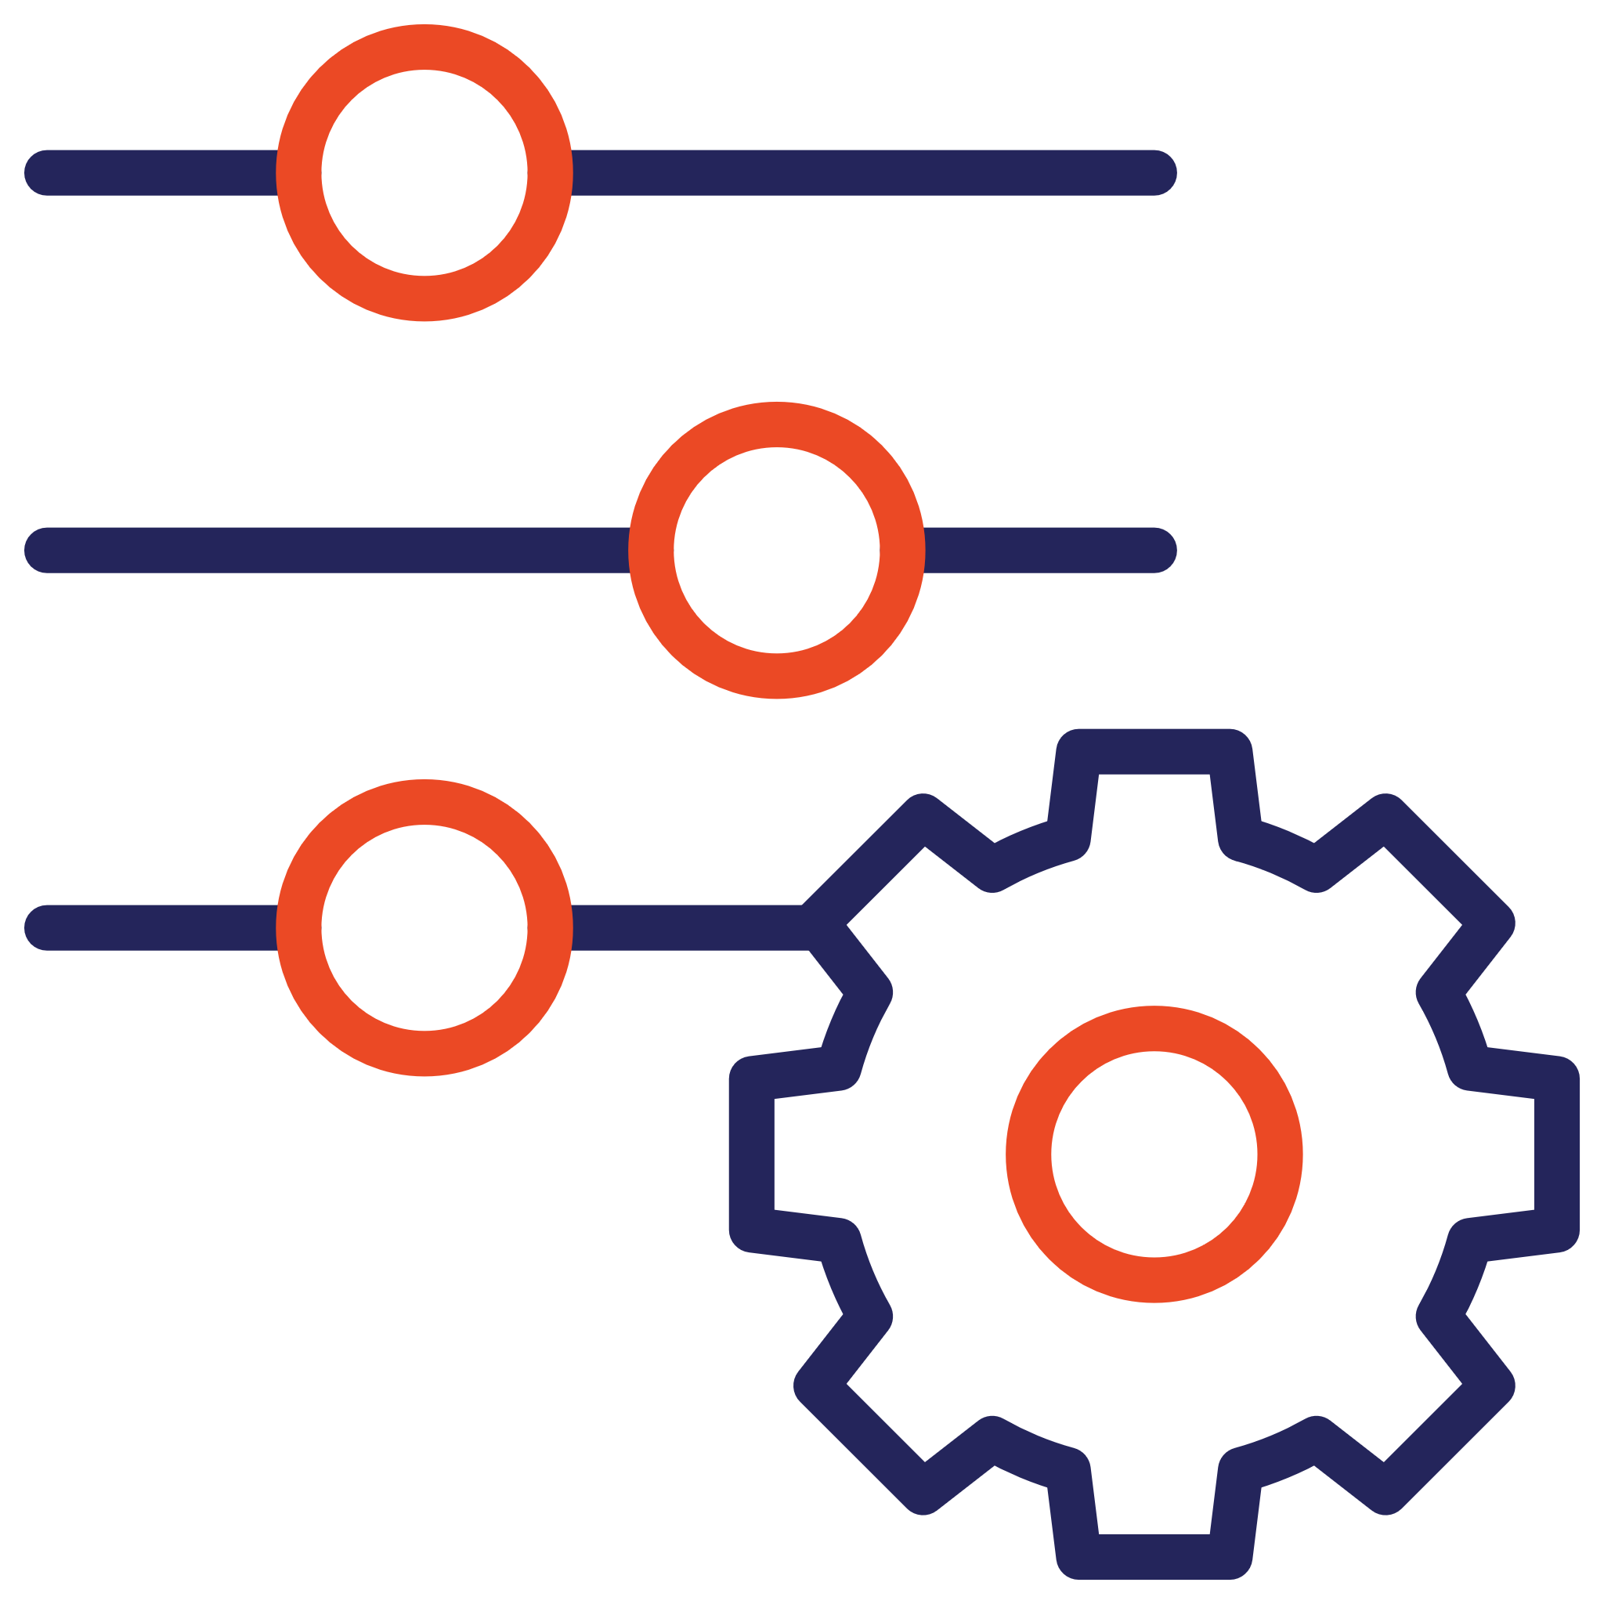
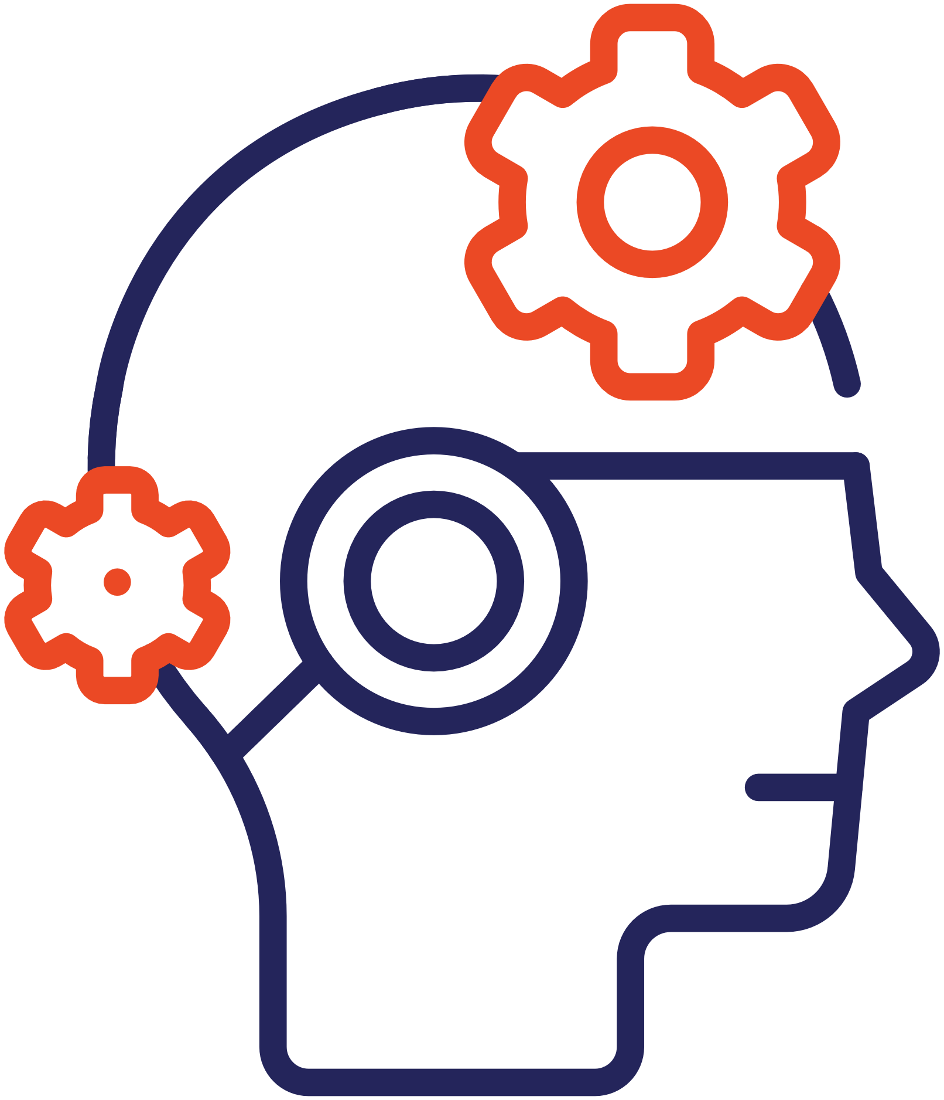







AI Driven Metrics Insights for Partners
The Challenge
Our AI-Driven Solution
Complex metrics with multiple parameters, qualification criteria, and categories.
Intelligent Metric Dissection: AI/NLP breaks down metrics into underlying parameters.
Lack of clarity in how metrics are calculated.
Self-Service Portal: Offer partners interactive access to detailed metrics, contextual help, and embedded learning resources.
Unclear definitions lead to misinterpretations that impact performance.
Actionable Recommendations: Tailored guidance to drive performance improvements.
No real-time visibility or what-if analysis for proactive performance improvement.
Benefits
Enhanced Transparency
Empowered Decision Making
Improved Performance

Slide 9





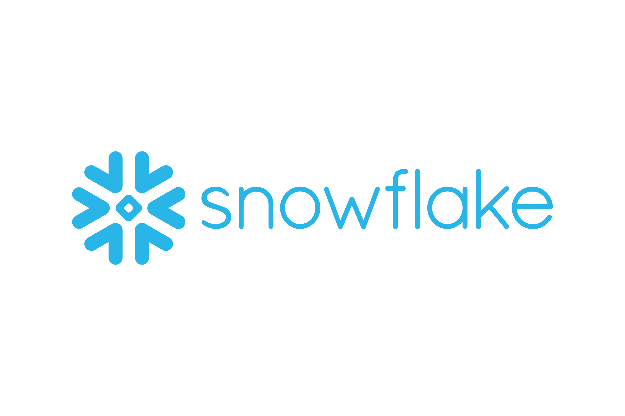


AI-Driven Performance Insights
Business Context: A global partner network sought to transform its traditional partner scorecard system into an intelligent, explainable insights engine. The objective was to enable thousands of partners across regions to access transparent, actionable, and predictive performance intelligence, and reduce dependency on manual dashboards or support teams.
Value Delivered
Common queries about metrics and scores were handled by the AI assistant, freeing up analysts and partner managers.
Reduced reliance on field teams and boosting self-service.
Explainable insights and scenario modeling enabled partners to act on data without delays or interpretation gaps.
Contextual nudges and personalized suggestions led to increased execution of growth-driving activities by partners.
Challenges
Solution Implemented
Metrics were calculated differently across regions and tools, often hardcoded in spreadsheets or SQL scripts, causing confusion and misalignment.
Partners and internal teams lacked clarity on what actions were impacting scores — dashboards showed what changed, not why.
Every metric explanation, performance deep-dive, or QBR preparation required analyst involvement, slowing down decision-making.
BI tools offered rigid reports with fixed filters and no drill-downs, scenario modeling, or ability to explore data intuitively.
Partners found dashboards too technical or generic, leading to poor adoption and over-reliance on field teams for interpretation.
Adapting dashboards for regional differences (language, currency, fiscal years, KPIs) required manual effort, delaying rollouts and increasing support costs.
Deployed AI models to translate complex, region-specific metric definitions into clear, consistent natural language explanations for both internal teams and partners.
Built a Looker-based analytics portal with drill-downs, guided metric breakdowns, and embedded explanations to reduce analyst dependency.
Integrated a Gemini-powered chat interface within dashboards to answer questions like “Why did my score drop?” or “How is my conversion rate calculated?”
Implemented a Retrieval-Augmented Generation engine to deliver contextual next-best actions tailored to each partner’s performance, vertical, and goals.
Enabled partners to simulate changes (e.g., increase deal size, reduce sales cycle) and instantly see projected impact on KPIs.
Enabled region-specific customizations (language, fiscal year, currency) while maintaining a single, AI-driven performance framework across global markets.
Technology Stack

Slide 10






LLM – RAG based Chatbot, Voicebots, Videobots
Project Overview: The traditional chatbots often struggle with understanding complex queries, providing personalized responses, handling ambiguity, and maintaining user engagement. Additionally, these chatbots face challenges with scalability, integration, and availability, leading to unsatisfactory user experiences. To overcome these issues, we implemented a solution utilizing Retrieval Augmented Generation. This implementation supports multimodal interactions, ensuring a seamless, engaging, and personalized user experience, while also providing 24/7 availability without the need for human intervention.
4o
Value Delivered
Enhanced Accuracy and Reliability
Valuable Customer Data and Feedback
Dynamic and Contextual Responses Eeduce reliance on human customer service representatives, leading to substantial cost savings.
Challenges
Approach
No more waiting in endless queues. RAG chatbots can understand your question and deliver the answer you need in seconds, freeing up human agents for trickier problems.
Many traditional chatbots operate on predefined scripts or rule-based systems, limiting their ability to understand and respond to complex or nuanced queries.
RAG chatbots can grasp the subtleties of human conversation, so they can tailor their responses to your specific situation and offer relevant solutions.
Integrating traditional chatbots with various data sources and systems to provide comprehensive and accurate responses can be complex.
Traditional chatbots often provide text-based interactions that can be perceived as monotonous and boring.
Utilized OpenAI's LLM to integrate powerful language models capable of understanding and generating human-like text.
Used ElevenLabs for realistic text-to-speech (TTS) conversion, enabling the creation of lifelike voice responses.
Langchain to manage conversational context and state across multiple interactions.
Used Langchain to manage various data formats, including CSV, DB, JSON, and PDF. Langchain can also extract content from Google when answers are not found in the provided data sources.
Integrated ChromaDB to handle fast and efficient data retrieval, allowing the bot to access and utilize large datasets for informed responses.
Developed support for multimodal interactions by combining text, voice, and video capabilities. Used OpenAI for text processing, ElevenLabs for voice synthesis, and open-source video generation tools for videobot functionality.
Tools Utilized

Slide 11


Virtual Relationship Manager
Project Overview: Aiming to revolutionize client relationship management, our Virtual Relationship Manager (VRM) addresses key challenges faced by traditional human relationship managers. Clients often encountered inconsistencies, limited availability, and scalability issues with RMs. The VRM features realistic, human-like voice interactions through Microsoft TTS, ensuring an engaging client experience. Designed for high scalability and efficiency, it includes a fallback mechanism for complex queries that redirects to human RMs.
Value Delivered
Significant cost savings and improved operational efficiency.
Timely and accurate responses to their queries, enhancing overall satisfaction and engagement.
Can handle large volume of client interactions simultaneously Leveraged data collected during client interactions to generate actionable insights, improving decision-making and strategy formulation.
Challenges
Approach
Scalability issues
Human RMs can only handle a limited number of clients simultaneously, leading to potential delays and reduced efficiency during peak times.
Scaling up the number of human RMs involves significant costs.
Consistency and Accuracy
The quality of service provided by human RMs can vary significantly based on their experience.
The potential for mistakes or omissions is higher with human RMs, which can impact client satisfaction and trust.
Employing and maintaining a team of human RMs involves high salaries, benefits, and overhead costs.
Consistent follow-up and proactive client engagement can be difficult to maintain, impacting client satisfaction and loyalty
Utilized Azure OpenAI LLM to handle client interactions. The model was fine-tuned with domain-specific data to ensure relevance and accuracy.
Twilio for robust and scalable communication capabilities, enabling the VRM to make voice calls to clients.
Implemented RAG using Langchain to enhance the VRM's ability to provide accurate and contextually relevant responses.
Enabled live call transfers to human RMs through Bland.AI when the VRM encounters complex queries or requires human intervention.
Implemented Microsoft TTS to generate realistic human-like voice responses, enhancing the overall client interaction experience.
Collect valuable datasets to improve the AI model, enhance service personalization, and get insights for better client management strategies.
Tools Utilized

Slide 12
Predicting Market Volatility and Value at Risk using Machine Learning Models
Business Context: A global investment bank aimed to enhance its market risk management capabilities by implementing machine learning (ML) models to predict market volatility and calculate Value at Risk (VaR). The traditional methods were found to be less accurate and slow in responding to sudden market changes, prompting the bank to explore advanced ML techniques.
Results
Enhanced Volatility Prediction::
The LSTM model reduced the Mean Absolute Error (MAE) of volatility predictions compared to the traditional GARCH model.
The Root Mean Squared Error (RMSE) was significantly lower, indicating more accurate and reliable volatility forecasts.
Improved VaR Calculation:
The GBM model provided more accurate VaR estimates, with a reduction in prediction error compared to traditional methods (e.g., historical simulation and parametric VaR).
Back-testing results showed that the GBM model's predicted VaR values closely matched actual market losses, with fewer exceedances beyond the predicted VaR threshold.
Objectives
Methodology
Develop an ML Model to Predict Market Volatility:
Create a machine learning model to analyze historical data and economic indicators, providing accurate forecasts of market volatility.
Enhance decision-making and risk management by anticipating market changes.
Calculate Value at Risk (VaR) Using ML Techniques:
Develop an ML model to calculate VaR, measuring potential portfolio losses over a specified period with a given confidence level.
Integrate market risk factors and historical returns to provide precise and dynamic VaR estimates
Model Selection and Training:
Volatility Prediction: A Long Short-Term Memory (LSTM) neural network was chosen for predicting market volatility due to its ability to capture temporal dependencies in time series data. The model was trained on historical price data and technical indicators.
Value at Risk (VaR): A Gradient Boosting Machine (GBM) model was used to estimate VaR. The GBM model was selected for its robustness in handling nonlinear relationships and interactions between features. The model was trained on historical returns and various market risk factors.
Model Validation and Testing: Metrics such as Mean Absolute Error (MAE) and Root Mean Squared Error (RMSE) were used to assess the accuracy of the volatility predictions.
The VaR model's performance was evaluated using back-testing, comparing predicted VaR values with actual market losses.
Value Delivered
The implementation of ML models reduced the time required for daily risk calculations, allowing for faster and more responsive risk management decisions.
The bank experienced a reduction in unexpected losses, as the models provided early warnings of increased market risk.

Slide 13
Portfolio Optimization using Machine Learning/AI
Business Context: An asset management firm sought to enhance its portfolio optimization process by leveraging machine learning (ML) and AI. The traditional methods, primarily based on Modern Portfolio Theory (MPT), were found to be suboptimal due to their inability to adapt quickly to changing market conditions and incorporate non-linear relationships among assets.
Results
Improved Returns:
The RL model effectively identified and capitalized on market opportunities, adjusting allocations dynamically.
Risk Management:
The volatility of the ML/AI-driven portfolio was lower than the traditional portfolio, indicating better risk management.
The maximum drawdown was reduced, demonstrating the model's ability to mitigate losses during market downturns.
Objectives
Methodology
The main objectives were to:
Optimize portfolio allocation to maximize returns while minimizing risks.
Incorporate non-linear relationships and interactions among assets using ML/AI.
Adapt to changing market conditions dynamically.
Model Selection and Training:
Reinforcement Learning: A reinforcement learning (RL) approach, specifically a Deep Q-Network (DQN), was chosen for its ability to learn and adapt to dynamic market conditions. The RL model was trained to maximize the cumulative reward, defined as the risk-adjusted return of the portfolio.
Supervised Learning: A Random Forest Regressor was used to predict expected returns and risk (volatility) for each asset, based on the engineered features.
Clustering: K-means clustering was applied to group similar assets based on historical performance and risk characteristics, aiding in diversification.
Portfolio Optimization Framework: The Reinforcement learning model was used to dynamically adjust portfolio weights based on market conditions and the predicted returns and risks from the Random Forest model. Constraints such as maximum exposure to any single asset, sector, or asset class were incorporated to ensure diversification and compliance with investment guidelines.
The Sharpe Ratio was used as the primary performance metric, balancing return and risk.
Value Delivered
The Sharpe Ratio of the ML/AI-driven portfolio was reflected a better risk-adjusted return.
The RL model's ability to adapt to changing market conditions was evident during periods of high volatility, where it reallocated assets to more stable investments.

Slide 14
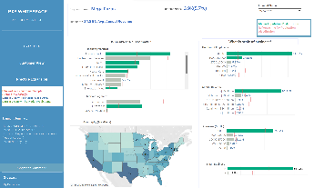
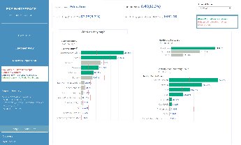
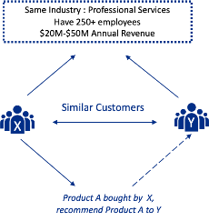



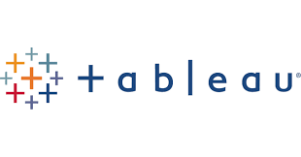
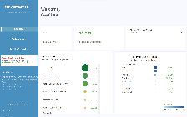
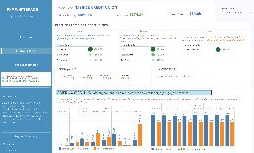
Customer Segmentation for Product Recommendation
Project Overview: Customer Segmentation and Opportunity assessment For An Information Technology And Networking Giant
Value Delivered
Challenges
Approach
Enhanced Customer Experience: Personalizing product recommendations by understanding the specific needs of different segments.
Numerous factors considered to identify customers who share similarities in terms of their likelihood of buying similar product - Industry /Market , Size /Scale, Market Demographics, Distinctive Attributes
Identify customer with similar businesses as they share common characteristics and face similar challenges and often tend to have similar product needs.
Product Sales: With improved targeting, the company can drive higher conversion rates and increase overall sales.
Automation of insight for new customers and changes in customer data
The output of the segmentation is presented on a Tableau Dashboard, which visually highlights the key differences among segments and aligns them with business objectives.
Using segmentation and AI/ML techniques, algorithms analyze variations in customer’s Bookings patterns with reference to similar customer from segment and predicted cross-selling upselling opportunities
Tools Utilized
Interpretability: ML models, operate as "black boxes," making it difficult to understand how they make decisions. This lack of transparency can hinder trust and adoption.
Python
Snowflake
Tableau

Slide 15

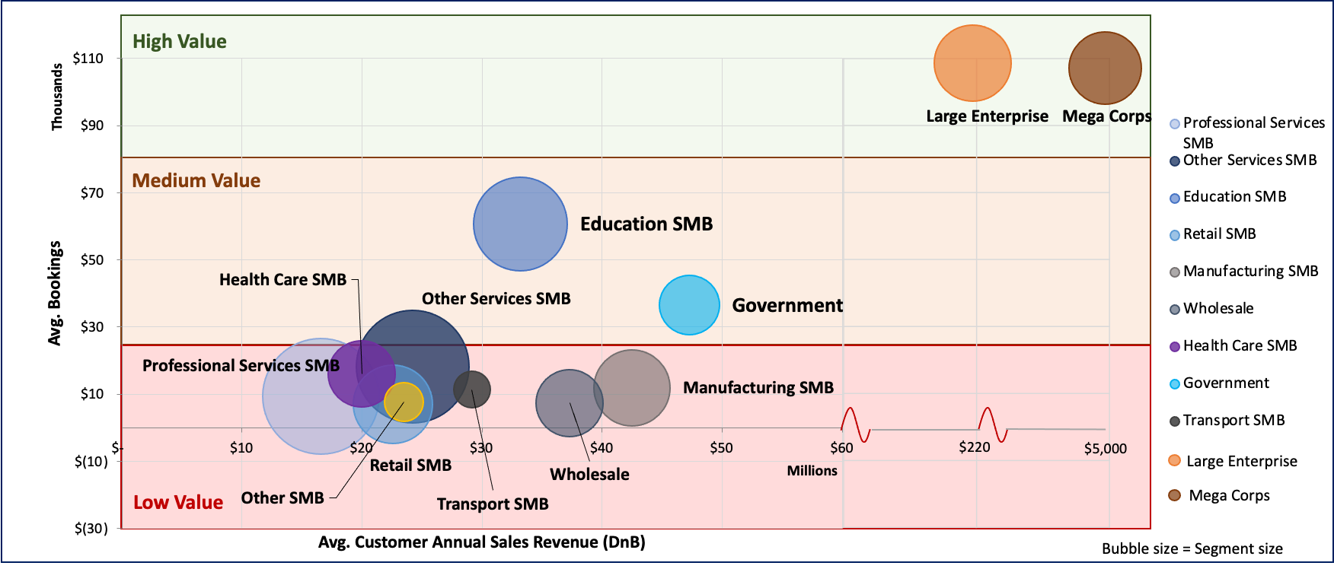
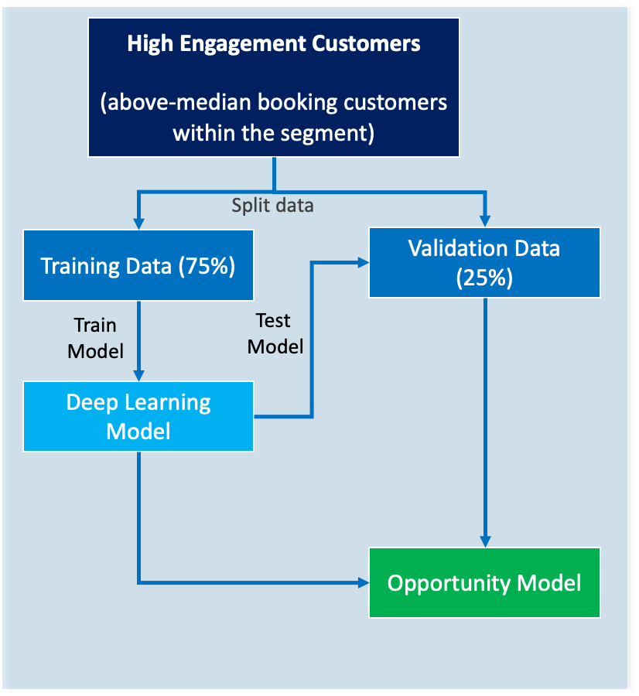

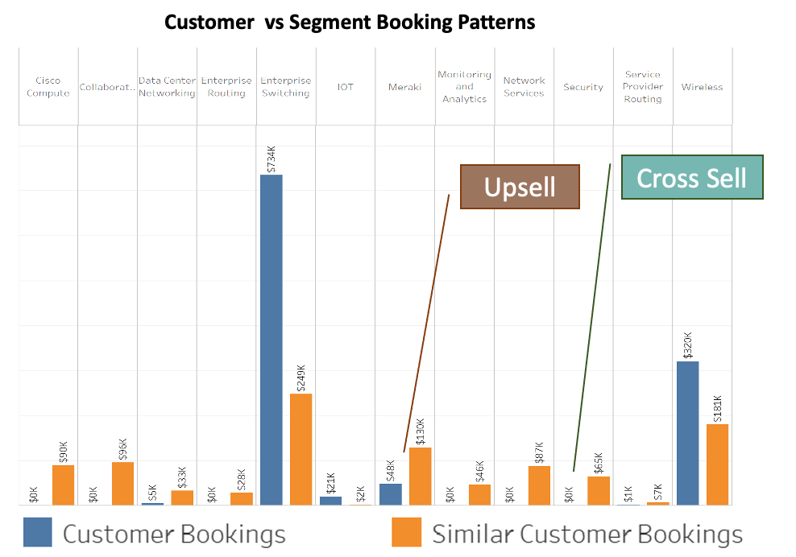
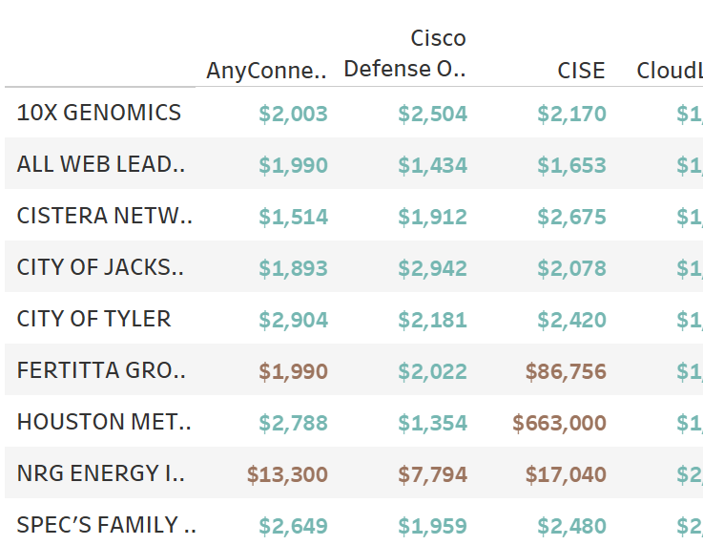



CASE STUDY:
Customer Opportunity Assessment
Customer Opportunity Assessment For An Information Technology And Networking Giant
BUSINESS PROBLEM
MODELING TECHNIQUE
DATA
We opted to use deep neural networks and XGBoost, their ability to analyze and predict opportunity using vast data which comprised customer purchase data, interaction histories and engagement patterns. The model was trained on historical sales data, customer interaction logs, support queries, and activity.
BOOKING DATA
FIRMOGRAPHIC DATA (DnB )
ENGAGEMENT DATA
COMPETITION DATA
Industry
The client aimed to better understand customer needs and predict buying behaviors to help optimize their Partner’s sales strategy.
TECHNOLOGY
OUTPUT
BUSINESS BENEFITS
TECH STACK
Function
CUSTOMER ENGAGEMENT
Increased Efficiency: The model streamlined the lead qualification, reducing the time partners spent on low-potential prospects.
Improved Partner Experience: With deeper insights into customer behaviors and preferences, enabling more personalized Partner sales approaches.
Realtime :
The algorithms were integrated to client's ecosystem for live updates
Python
Snowflake
Impact
REDUCTION IN LEAD QUALIFICATION TIME BY ~15%
Using segmentation and ML techniques, algorithms analyze variations in customer’s Bookings patterns with reference to similar customer from segment and predicted cross-selling upselling opportunities.

